Slide 1
Entity Relationship Model

Slide 2
The Entity-Relationship Model
An entity is an object that exists and is distinguishable from other objects.
Example: specific person, company, event, plant
Entities have attributes
Example: people have names and addresses
An entity set is a set of entities of the same type that share the same properties.
Example: set of all persons, companies, trees, holidays

Slide 3
Attributes
An entity is represented by a set of attributes, that is descriptive properties possessed by all members of an entity set.
Example:
instructor = (ID, name, street, city, salary ) course= (course_id, title, credits)
Domain – the set of permitted values for each attribute
Attribute types:
Simple and composite attributes.
Single-valued and multivalued attributes
Derived attributes

Slide 4
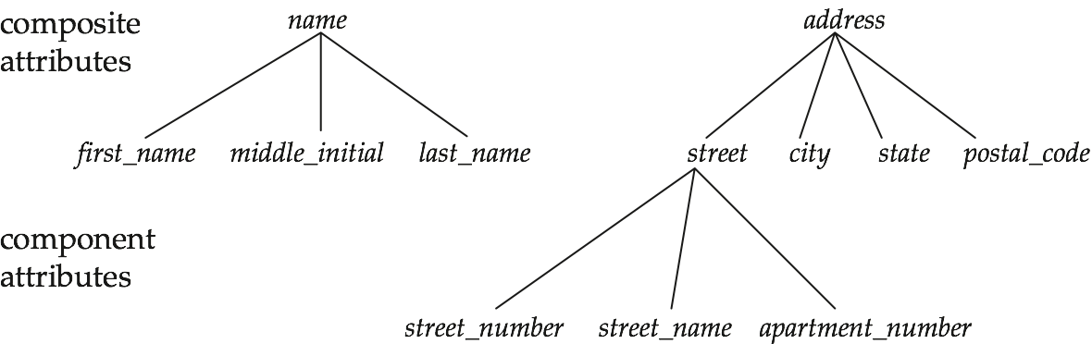
Types of Attributes
Simple Attribute: Attribute that consist of a single atomic value. Example: Salary
Composite Attribute : Attribute value not atomic. Example : Address : ‘House _no:City:State Name : ‘First Name: Middle Name: Last Name’

Slide 5
Types of Attributes
Single Valued Attribute: Attribute that hold a single value
Exampe1: City Example2:Customer id
Multi Valued Attribute: Attribute that hold multiple values.
Example1: A customer can have multiple phone numbers, email id's etc Example2: A person may have several college degrees
Derived Attribute: An attribute that’s value is derived from a stored attribute.
Example : age, and it’s value is derived from the stored attribute Date of Birth.

Slide 6
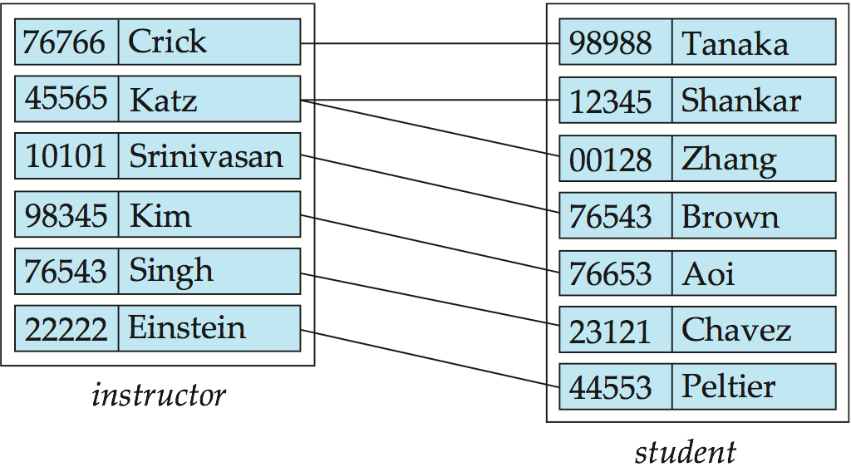
Relationship Sets
A relationship is an association among several entities
Example: 44553 (Peltier) advisor 22222 (Einstein) student entity relationship set instructor entity

Slide 7
Entity-Relationship Diagrams
Representing entities
CUSTOMER
PART-TIME
EMPLOYEE

Slide 8
Entity-Relationship Diagrams
Representing relationship
DEPT
EMPLOYEE
employs

Slide 9
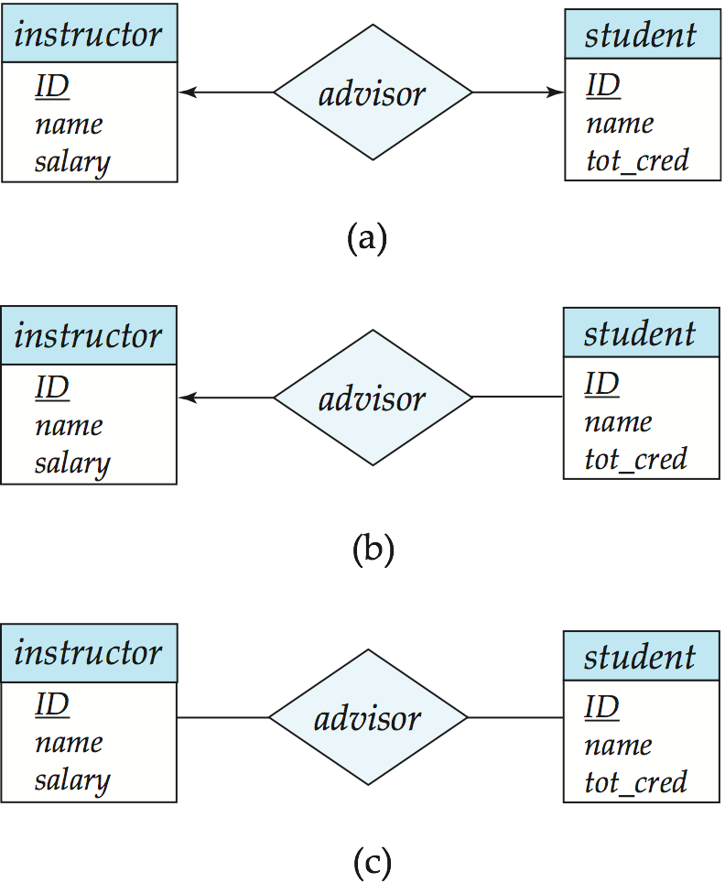
Cardinality Constraints
We express cardinality constraints by drawing either a directed line (→), signifying “one,” or an undirected line (—), signifying “many,” between the relationship set and the entity set.
Or, by numbering each entity. * or, m for many.
One-to-one relationship:
A student is associated with at most one instructor via the relationship advisor
A student is associated with at most one department via stud_dept
1
1

Slide 10
One-to-Many Relationship
one-to-many relationship between an instructor and a student
an instructor is associated with several (including 0) students via advisor
a student is associated with at most one instructor via advisor,
1
*

Slide 11
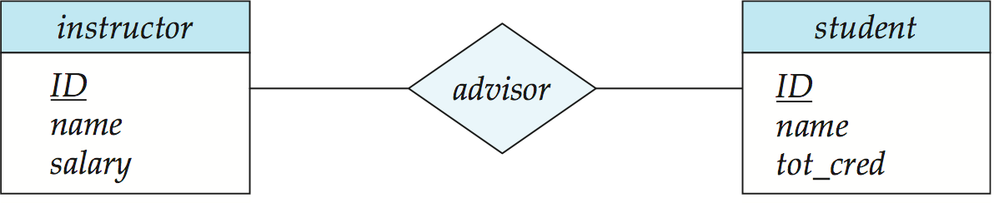
Many-to-Many Relationship
Many-to-many relationship between An instructor is associated with several (possibly 0) students via advisor
A student is associated with several (possibly 0) instructors via advisor
*
*

Slide 12
Entity-Relationship Diagrams
Crow’s foot notation: A type of cardinality notation. It is called crow's foot notation because of the shapes, which include circles, bars, and symbols, that indicate various possibilities.
A single bar indicates one, a double bar indicates one and only one, a circle indicates zero, and a crow's foot indicates many.

Slide 13
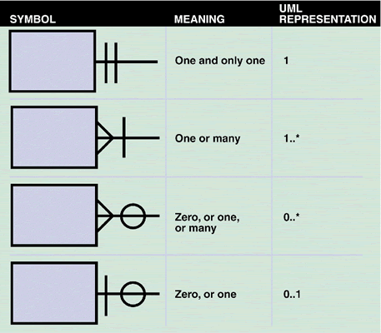
Entity-Relationship Diagrams
Crow's foot notation is a common method of indicating cardinality. The four examples show how you can use various symbols to describe the relationships between entities.

Slide 14
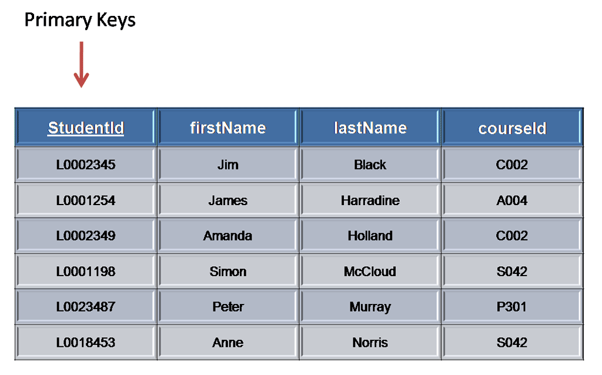
Primary Key
A primary key is a candidate key that is most appropriate to be the main reference key for the table. As its name suggests, it is the primary key of reference for the table and is used throughout the database to help establish relationships with other tables.
The primary key must contain unique values, must never be null and uniquely identify each record in the table

Slide 15
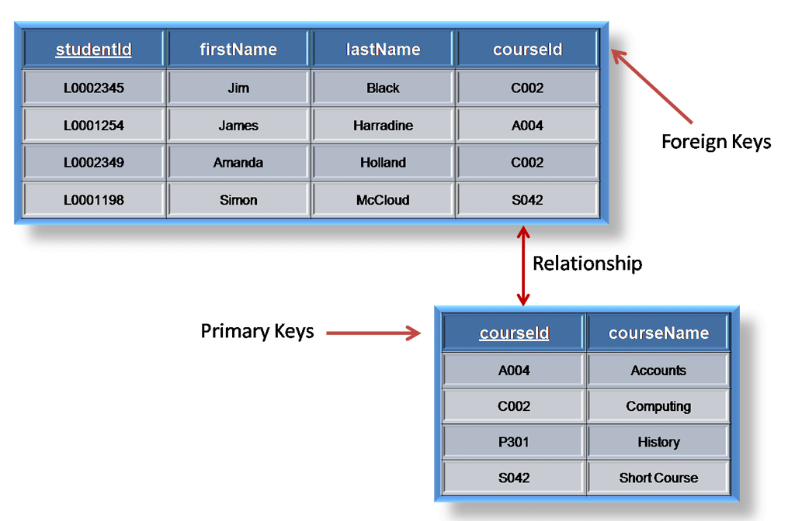
Foreign Key
A foreign key is generally a primary key from one table that appears as a field in another where the first table has a relationship to the second. In other words, if we had a table A with a primary key X that linked to a table B where X was a field in B, then X would be a foreign key in B

Slide 16

E-R Diagrams
Rectangles represent entity sets.
Diamonds represent relationship sets.
Attributes listed inside entity rectangle. Or , as oval shape along with the rectangle.
Underline indicates primary key attributes

Slide 17
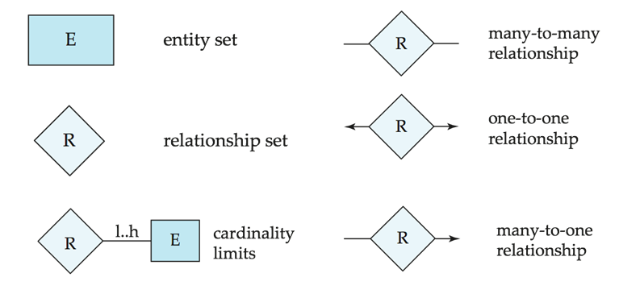
Summary of Symbols Used in E-R Notation

Slide 18
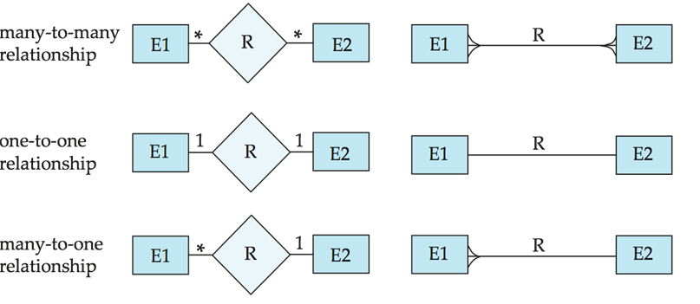
Summary of Symbols Used in E-R Notation
Crows feet notation

Slide 19
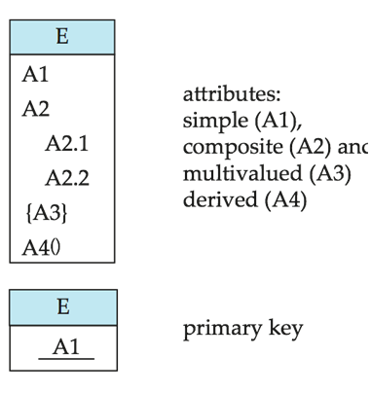
Summary of Symbols Used in E-R Notation
Representing attributes

Slide 20
Participation of an Entity Set in a Relationship Set
Total participation (indicated by double line): every entity in the entity set participates in at least one relationship in the relationship set
E.g. participation of loan in borrower is total
every loan must have a customer associated to it via borrower
Partial participation: some entities may not participate in any relationship in the relationship set
Example: participation of customer in borrower is partial

Slide 21
Weak Entity Sets
An entity set that does not have a primary key is referred to as a weak entity set.
The existence of a weak entity set depends on the existence of a identifying entity set
it must relate to the identifying entity set via a total, one-to-many relationship set from the identifying to the weak entity set
Identifying relationship depicted using a double diamond

Slide 22
Weak Entity Sets (Cont.)
We depict a weak entity set by double rectangles & relationships by double diamond.
We underline the discriminator of a weak entity set with a dashed line.

Slide 23
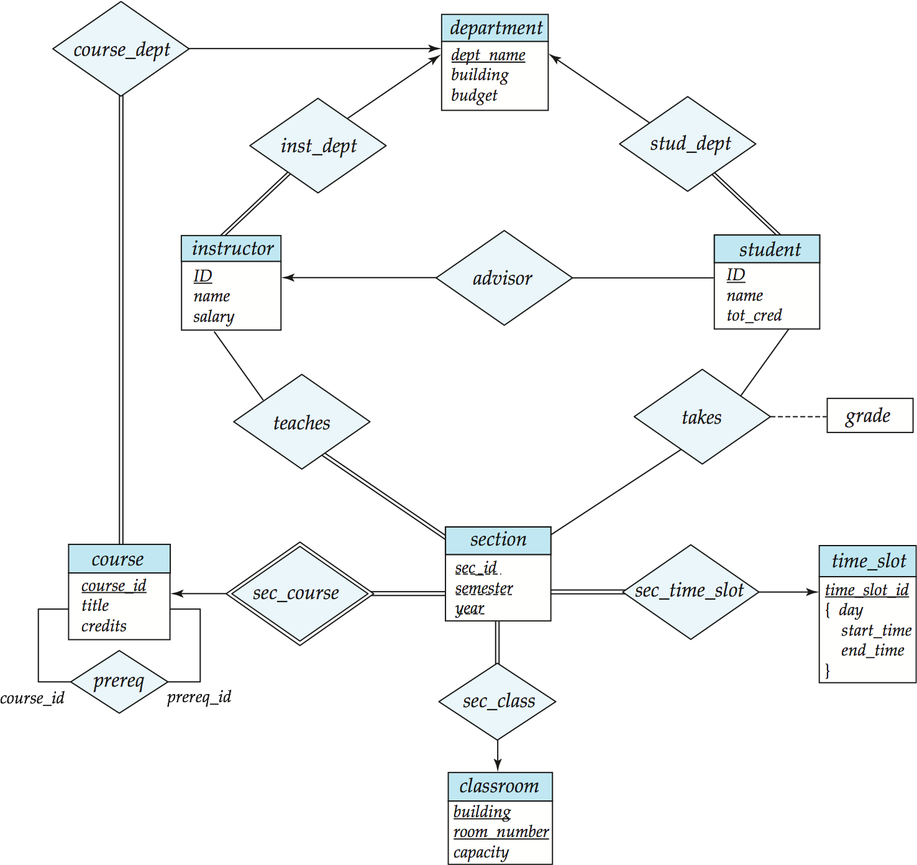
E-R Diagram for a University

Slide 24
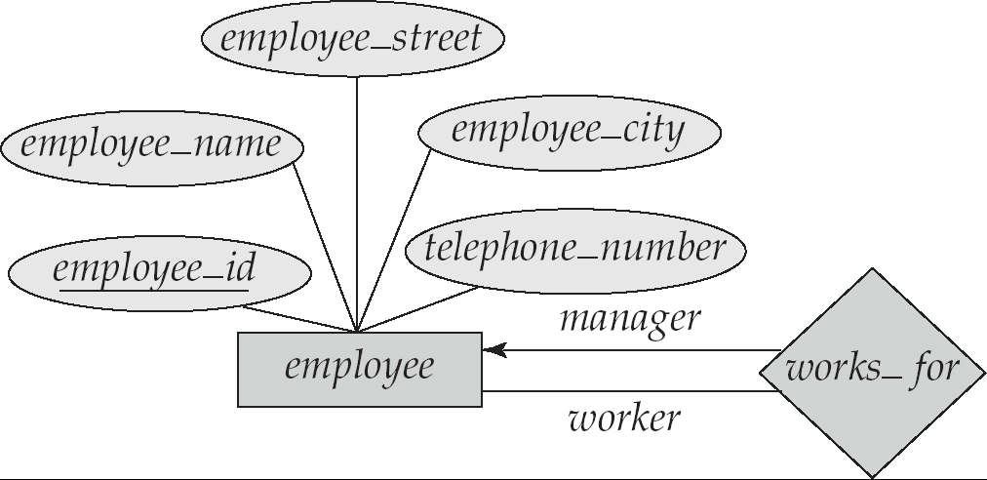

Slide 25
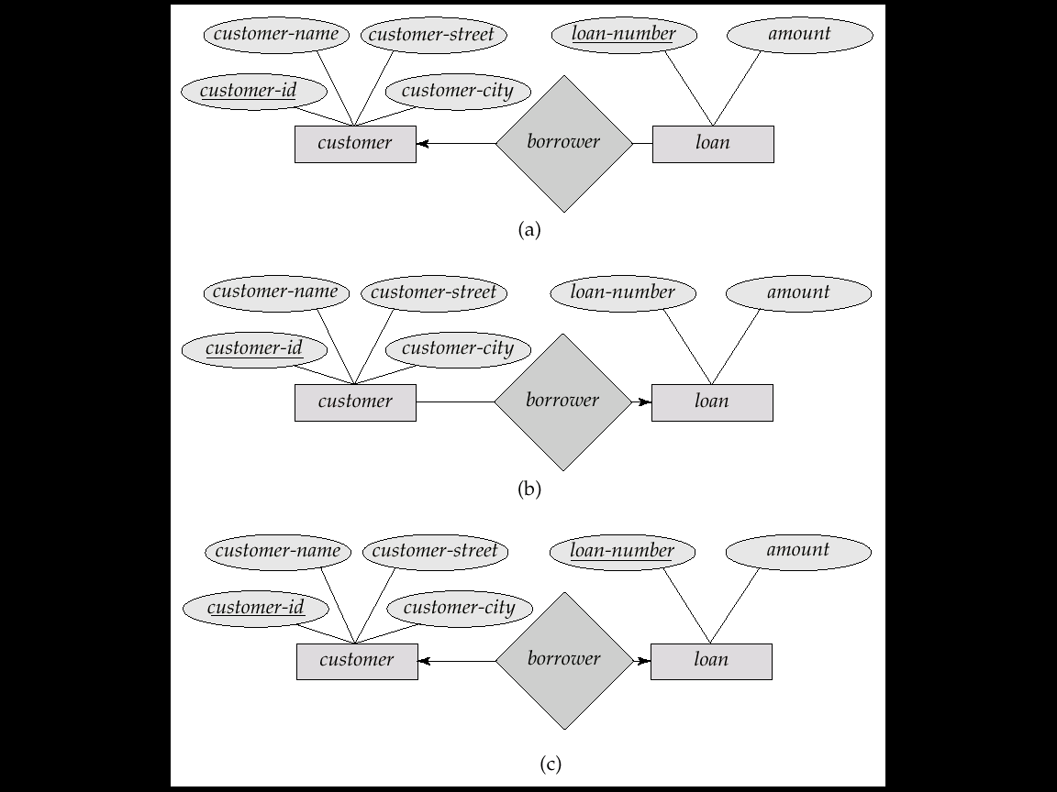
One-To-Many Relationship

Slide 26
Many-To-One Relationships

Slide 27
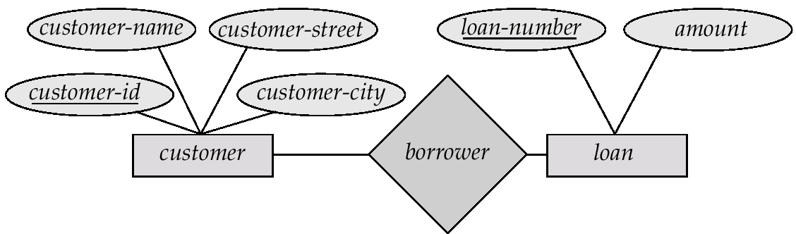
Many-To-Many Relationship

Slide 28
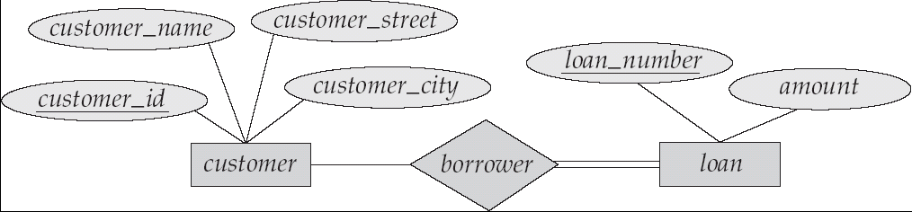
Total Participation

Slide 29
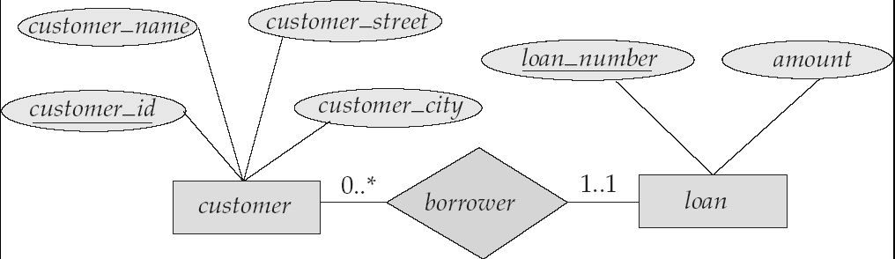
Cardinality Constraints

Slide 30
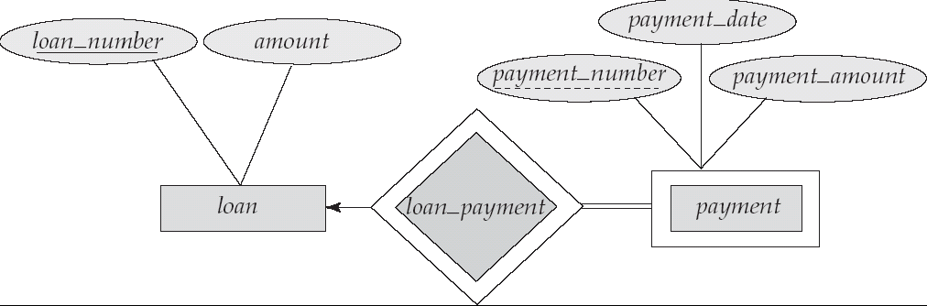
Weak entity

Slide 31
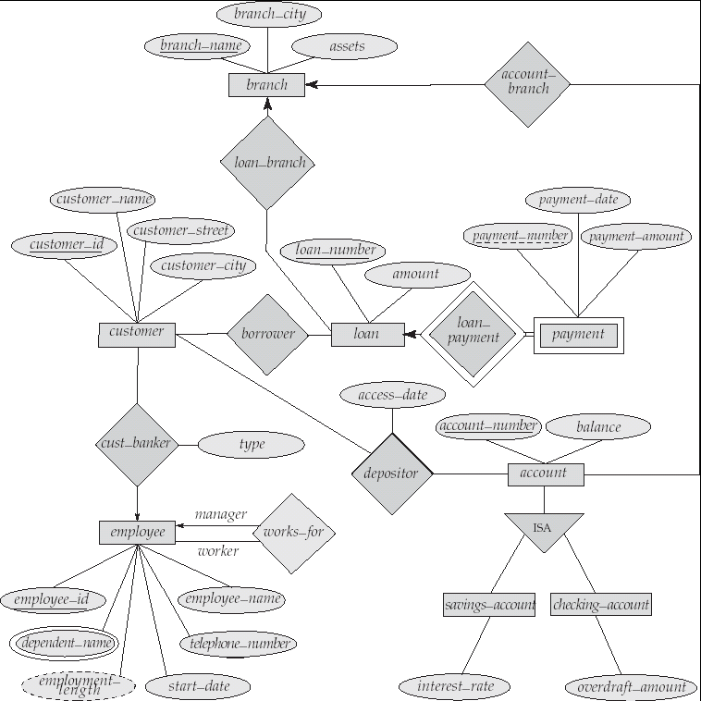
E-R Diagram for a Banking Enterprise

Slide 32
Thank you
Notes:
32

